Slide 1
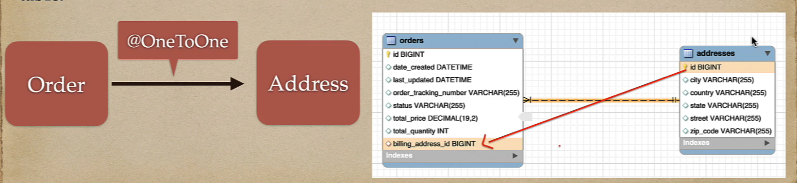
One to One Mapping
We will take Order and the Address (billing address) entities to perform One to One mapping.
Each Order has exactly one Address and Each Address belongs to one Order.
On the database level, this mapped by a foreign key column either on the Address or the Order table.
The @OneToOne JPA annotation is used to map the source entity with the target entity.
Example: User -> UserProfile, Employee -> EmployeeDetail, Instructor -> InstructorDetail

Slide 2
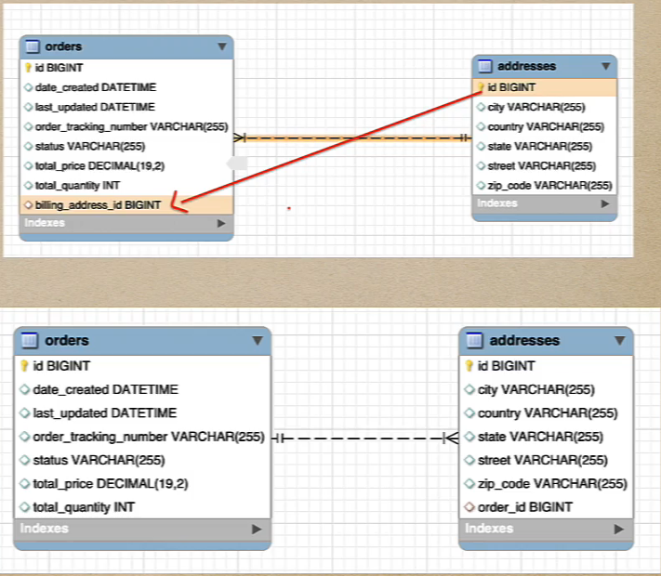
One to One Mapping
The one-to-one mapping/association can be either unidirectional or bidirectional.
In unidirectional association, source entity has a relationship field that refers to the target entity and the source entity’s table contains the foreign key.
In bidirectional association, each entity(i.e source and target) has a relationship field that refers to each other and the target entity’s table contains the foreign key. The source entity must use the mappedBy attribute to define the bidirectional one-to-one mapping.

Slide 3
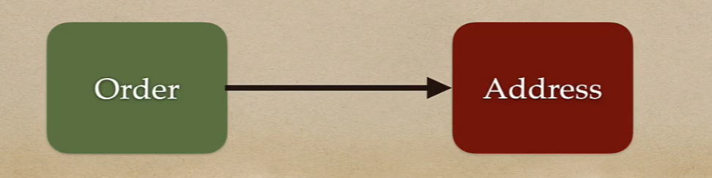
One to One Unidirectional Mapping
We will take Order and Address (billing address) entities to perform One to One Unidirectional mapping.
One Order can have only one Address (billing address)
One way relationship between Order and Address
If we load Order entity then we can get associated billing address using unidirectional mapping but vice versa is not possible.

Slide 4
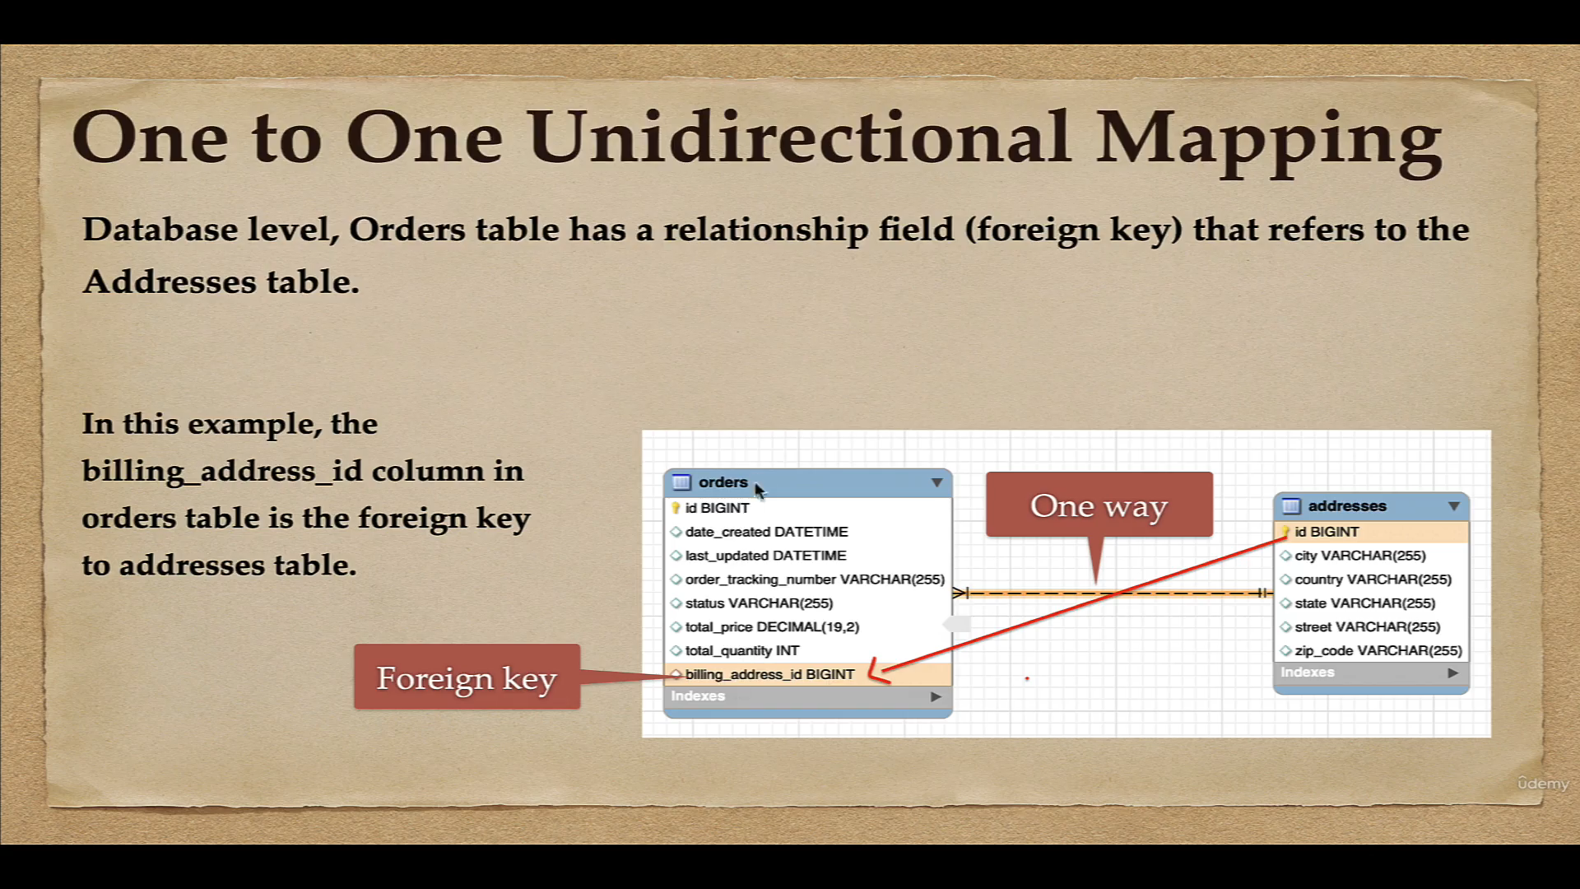

Slide 5
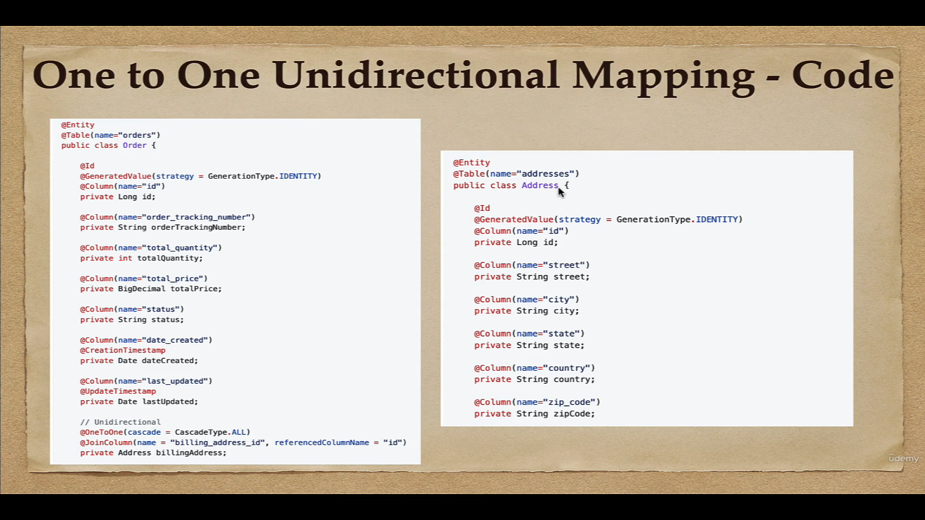

Slide 6
Cascading Examples
Example 1: Order – Billing Address relationship. Without the Order, the Billing Address entity doesn’t have any meaning of its own. When we delete the Order entity, our Billing Address entity should also get deleted.
Example 2: Order and OrderItems relationship
Cascading is the way to achieve this. When we perform some action on target entity, the same action will be applied to the associated entity.
When we save(delete, change/merge) parent entity then it’s child entities will automatically saved(delete, change/merge).

Slide 7
JPA Supported Cascade Types
CascadeType.PERSIST: cascade type persist means that save() or persist() operations cascade to related entities.
CascadeType.MERGE: cascade type merge means that related entities are merged when the owning entity in merged.
CascadeType.REFRESH: cascade type refresh does the same thing for refersh() operation.
CascadeType.REMOVE: cascade type remove removes all related entities association with this setting when the owning entity deleted.
CascadeType.DETACH: cascade type detach detaches all related entities if a ‘manual detach’ occurs.
CascadeType.ALL: cascade type all is shorthand for all of the above cascade operations.

Slide 8

New Use Case
If we load the Address then we would like to get the associated Order
This is not possible with current unidirectional mapping

Slide 9
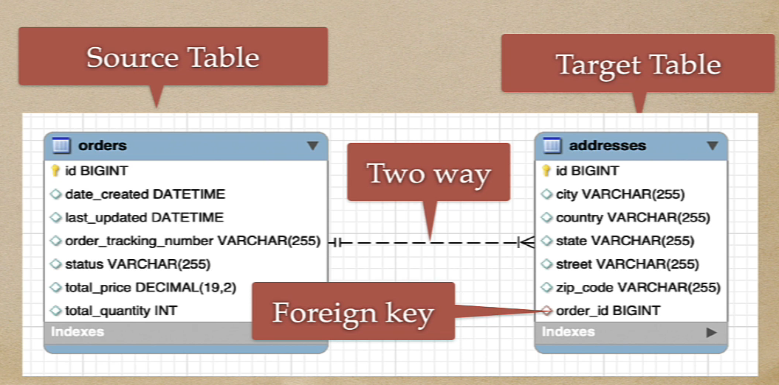
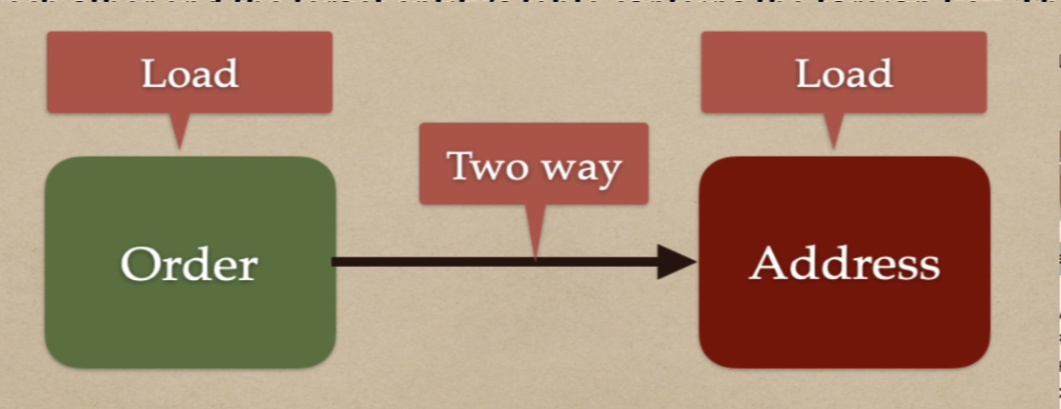
One to One Bidirectional Mapping
In bidirectional association, each entity(i.e source and target) has a relationship field that refers to each other and the target entity’s table contain the foreign key. The source entity must use the mappedBy attribute to define the bidirectional one-to-one mapping.
In this example, the order_id column in address table is the foreign key to orders table.

Slide 10
